Slide 1


Slide 2
Hive Features
Commonly used data warehousing tool
Introduces a data query language called HiveQL (Hive Query Language) similar to SQL
Maintains a tabular abstraction to data present on HDFS
Tables have columns & data types just like in any relational database
It is a schema-on-read platform
Update of data is not possible
No transactions, no rollbacks, no transaction isolation level
No primary keys, no foreign keys
Incorrectly formatted data or any data for which a value cannot be found is simply reported as “null”
Table definitions are stored in the metastore database

Slide 3
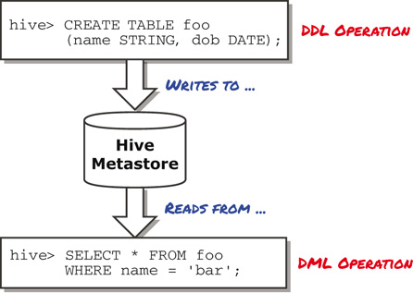
Role of Metastore DB
DDL is Data Definition Language : it is used to define data structures. such as create table
DML is Data Manipulation Language : it is used to manipulate data itself. such as insert, update, delete
Notes:
DDL is Data Definition Language : it is used to define data structures.
For example, with SQL, it would be instructions such as create table, alter table, ...
DML is Data Manipulation Language : it is used to manipulate data itself.
For example, with SQL, it would be instructions such as insert, update, delete, ...

Slide 4
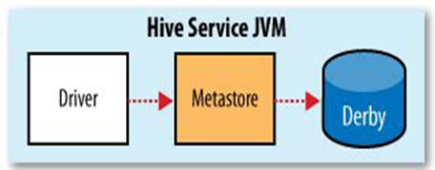
Metastore DB Modes - Embedded
Default mode
Used for experimental purposes only
Both the database and the metastore service are embedded in the main HiveServer process
Both are started when the HiveServer process started
Supports only one user/session at a time

Slide 5
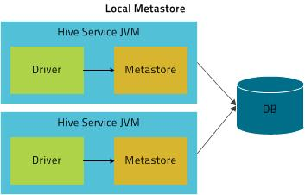
Metastore DB Modes - Local
The metastore service & the HiveServer run in the same process
The metastore DB runs in a separate process
The metastore service communicates with the DB through JDBC
Notes:
JDBC stands for Java Database Connectivity. JDBC is a Java API to connect and execute the query with the database.

Slide 6
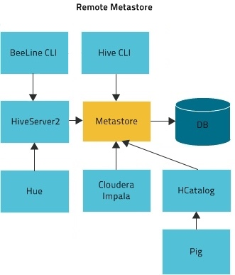
Metastore DB Modes - Remote
The metastore service runs on its own JVM
Clients like Hive server, Hcatalog, Impala etc. communicate with the metastore service using the Thrift Network API (property: hive.metastore.uris)
The metastore DB runs in a separate process
The metastore service communicates with the DB through JDBC
The metastore service & hive server processes may be on the same host, but it is recommended to be on separate hosts
Recommended for Production setups
Notes:
Link to Cloudera metastore configuration site:
https://www.cloudera.com/documentation/enterprise/5-8-x/topics/cdh_ig_hive_metastore_configure.html

Slide 7
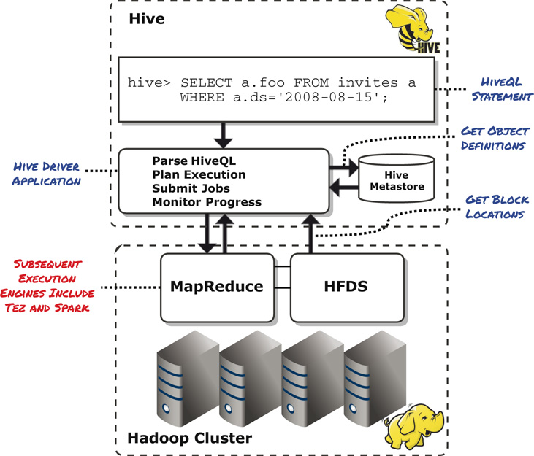
Hive Execution

Slide 8
Run Hive Queries - Modes
Inside the hive prompt
select * from stations;
Outside the hive prompt, through a statement
hive -e “select * from stations”
Outside the hive prompt, from a file (script example)
hive -f stations_query.hql

Slide 9
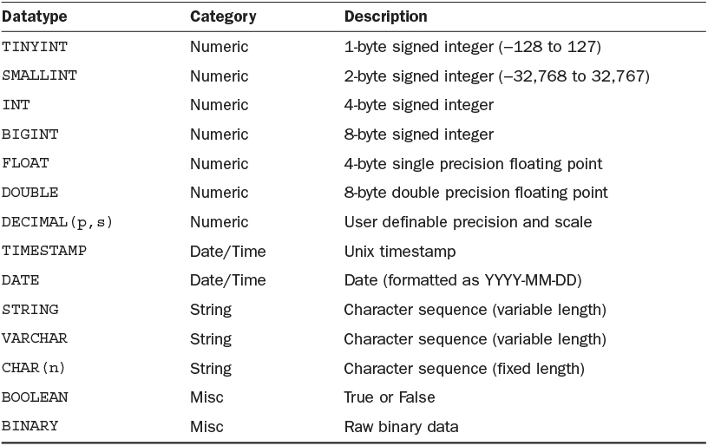
Hive Datatypes
Notes:
Boolean miscellaneous

Slide 10
Create Table
CREATE TABLE stations
> (
> station_id INT,
> name STRING,
> lat DOUBLE,
> long DOUBLE,
> dockcount INT,
> landmark STRING,
> installation STRING
> )
> ROW FORMAT DELIMITED
> FIELDS TERMINATED BY ',’
> STORED AS TEXTFILE;

Slide 11
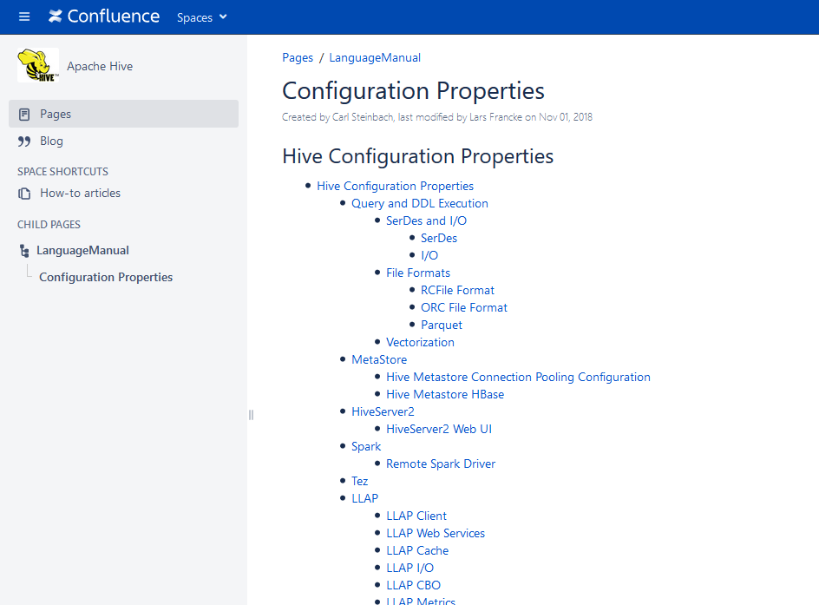
Hive Configuration Parameters
https://cwiki.apache.org/confluence/display/Hive/Configuration+Properties
Notes:
https://cwiki.apache.org/confluence/display/Hive/Configuration+Properties

Slide 12

I/O Formats in Hive
TEXTFILE
SEQUENCEFILE
ORC
PARQUET
AVRO
Notes:
Basic file formats are: Text format, Key-Value format, Sequence format.
Other formats which are used and are well known are: Avro, Parquet, RC or Row-Columnar format, ORC or Optimized Row Columnar format.

Slide 13
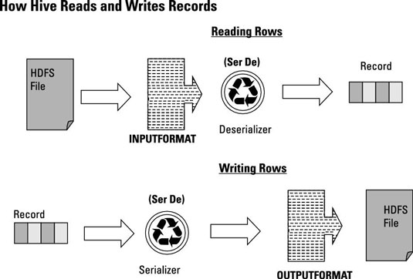
SerDe’s in Hive
Translates it into a Java object
Translate to string or binary representation of a record
Notes:
The SerDe interface allows you to instruct Hive as to how a record should be processed. A SerDe is a combination of a Serializer and a Deserializer (hence, Ser-De). The Deserializer interface takes a string or binary representation of a record, and translates it into a Java object that Hive can manipulate.
LazySimpleSerDe
RegexSerDe

Slide 14
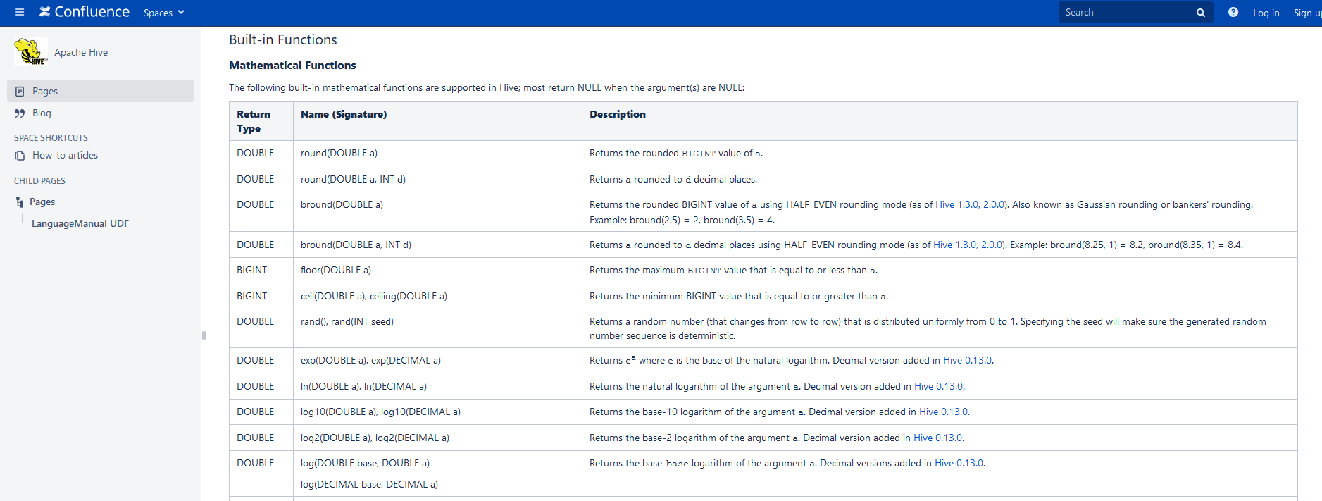
Built-in Functions
https://cwiki.apache.org/confluence/display/Hive/LanguageManual+UDF#LanguageManualUDF-Built-inFunctions

Slide 15
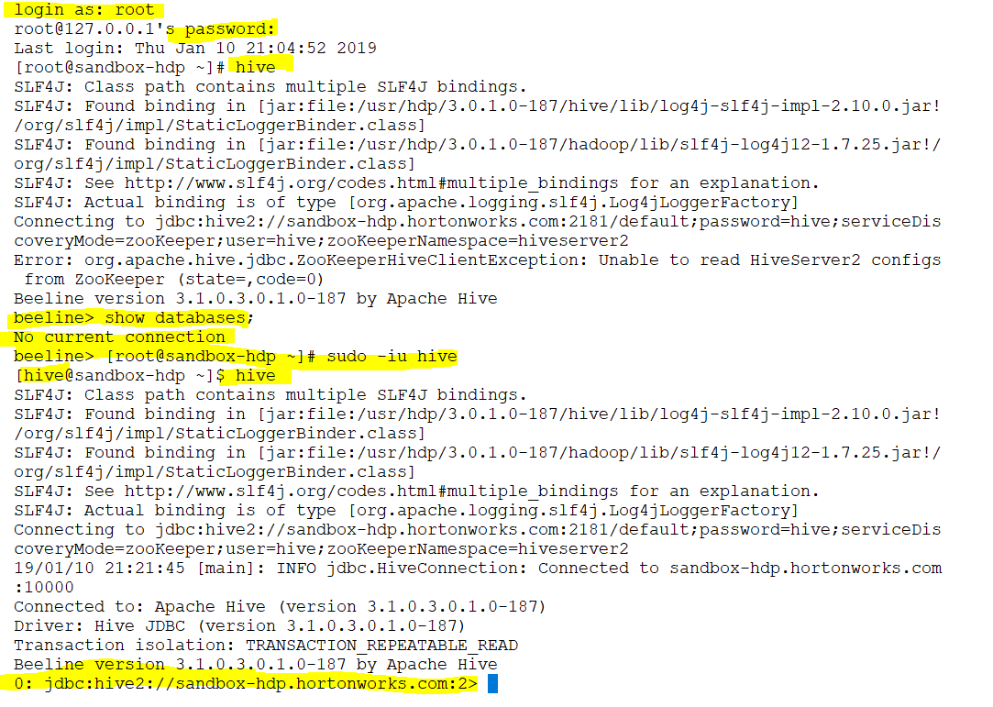

Slide 16
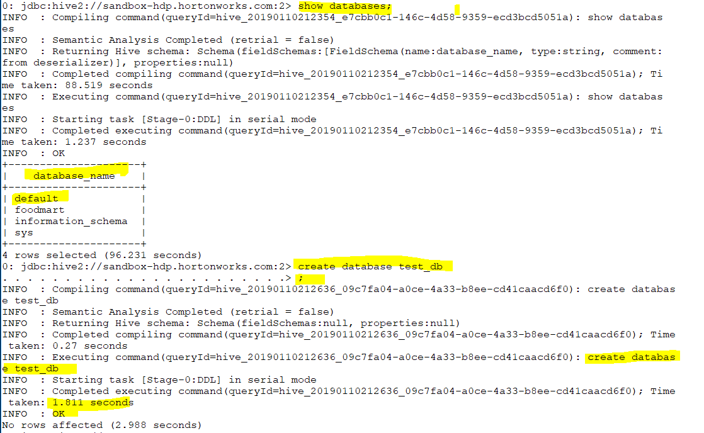

Slide 17
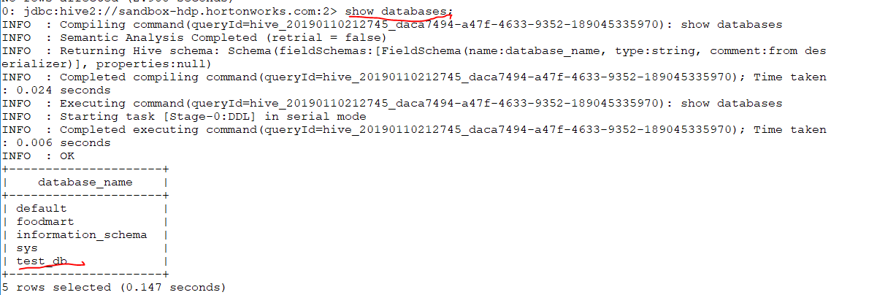
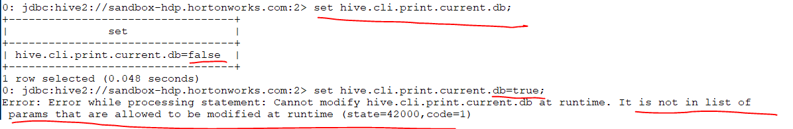
Notes:
How I know which db I am using ? By running set command but you see that I can not change it to true .Why ? Because based on next page I can not find that entity there and change it (hive-core.xml)

Slide 18
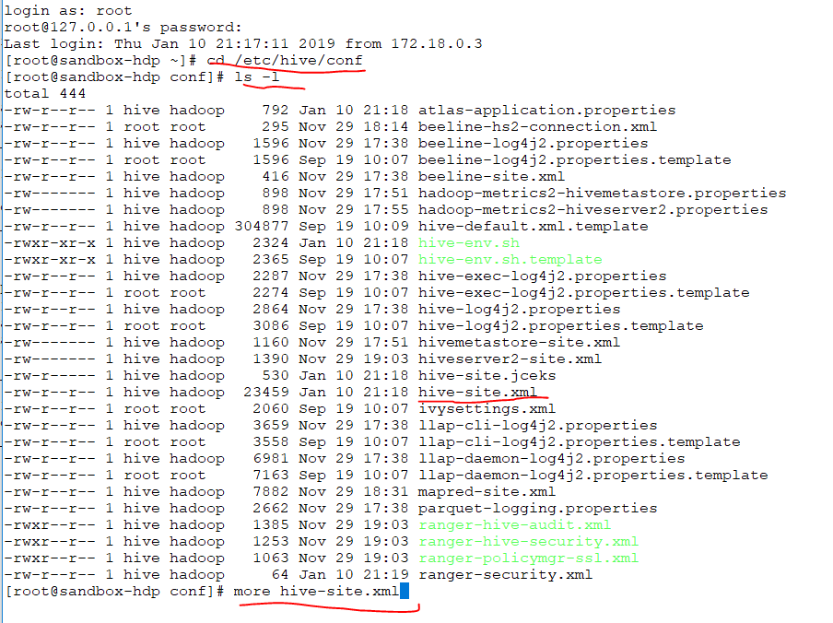

Slide 19
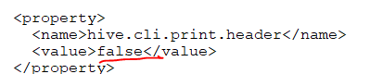
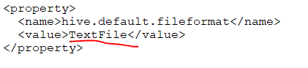
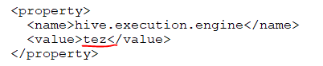
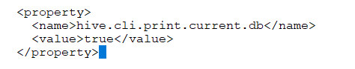
Notes:
o print header along with the output, the following hive conf property should be set to true before executing the query. hive> set hive.cli.print.header=true; hive>
We need to add this section to the previous file so after restarting the hive we can see which data base we are logged in.

Slide 20
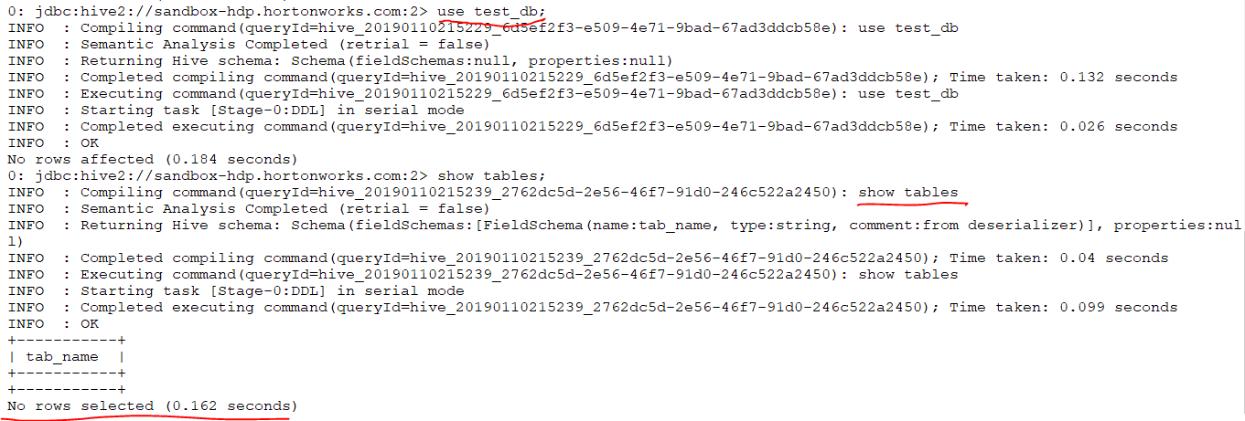

Slide 21
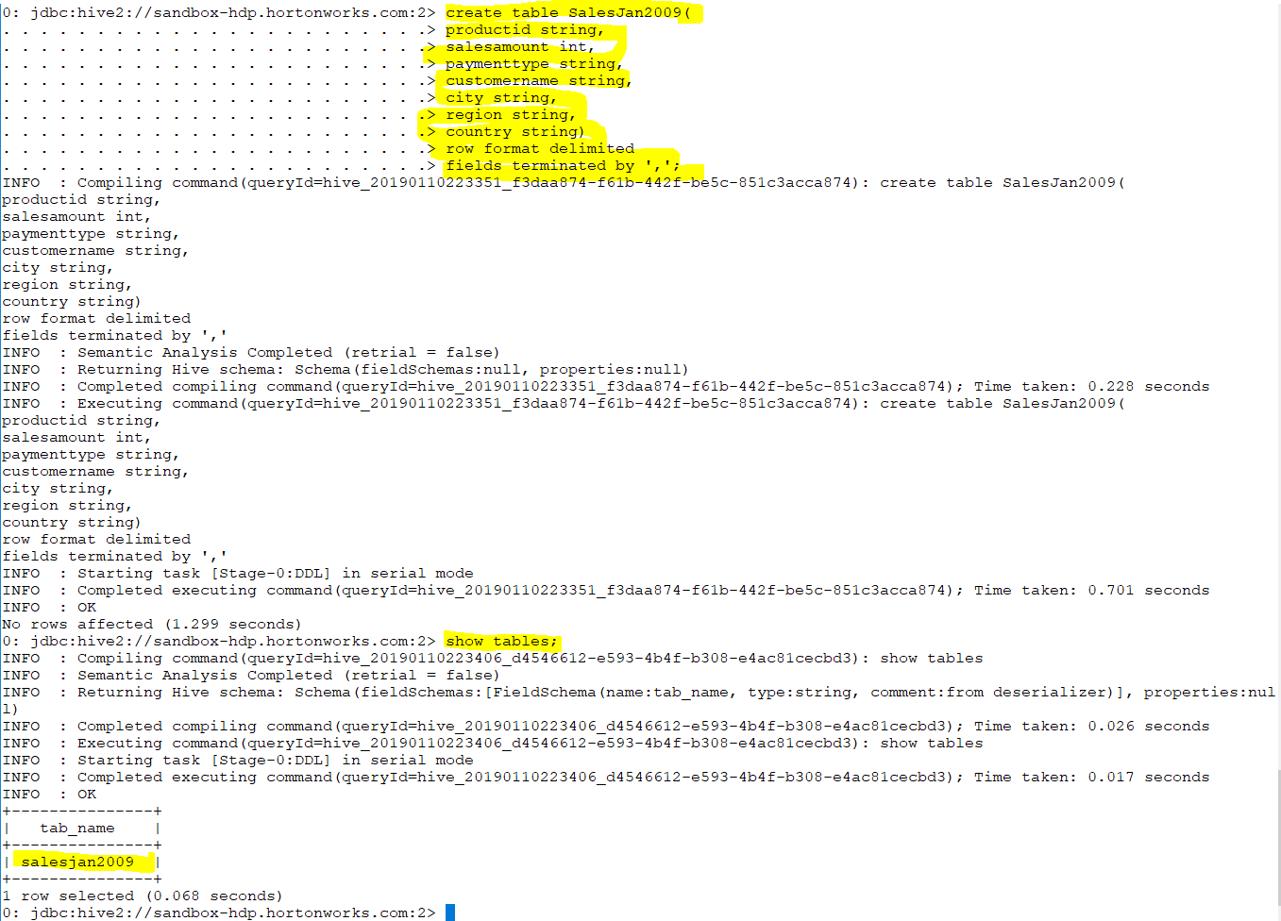
Notes:
Hive-site.xml

Slide 22
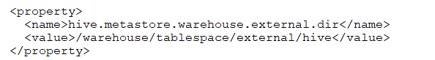
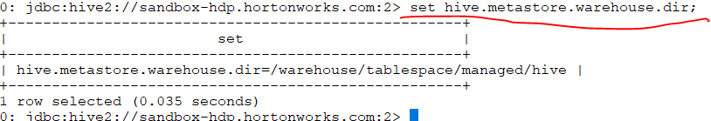
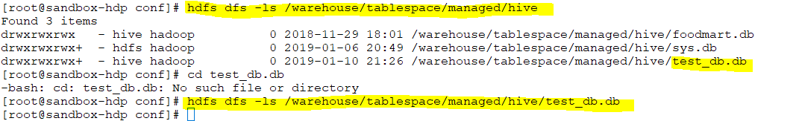
Hive-site.xml
Notes:
Any time you create a db hive will create A FOLDER call test_db .It will paste it on /warehouse/tablespace/managed/hive .How do we know ? By knowing the property of Hive-site.xml
And run the set commands we learn about /warehouse/tablespace/managed/hive
If you delete a db It will delete it here as well (/warehouse/tablespace/managed/hive)
So metadata and data will be removed.

Slide 23
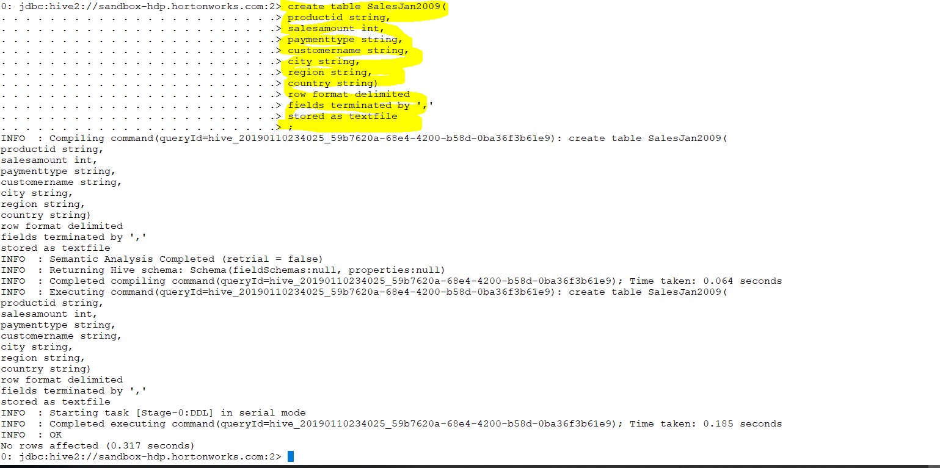
Managed table

Slide 24
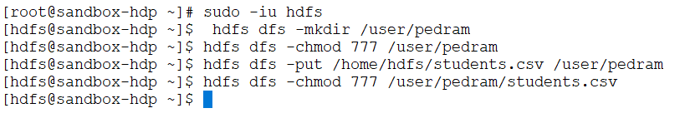
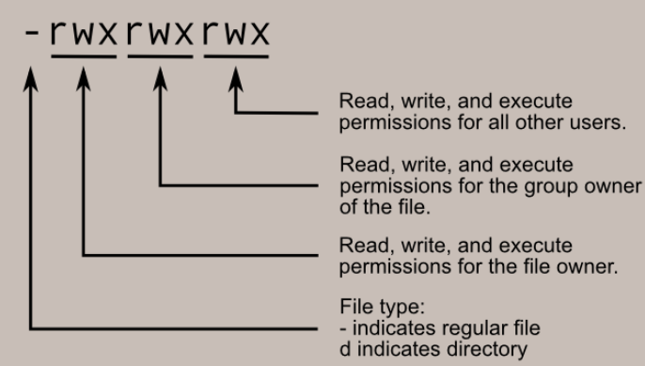

Slide 25
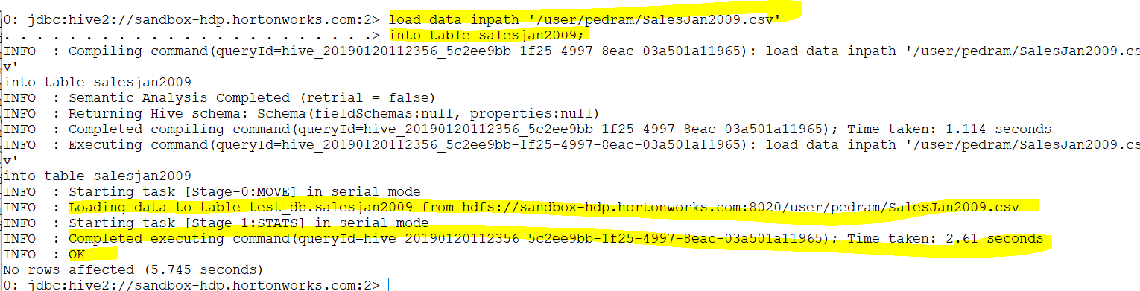

Slide 26
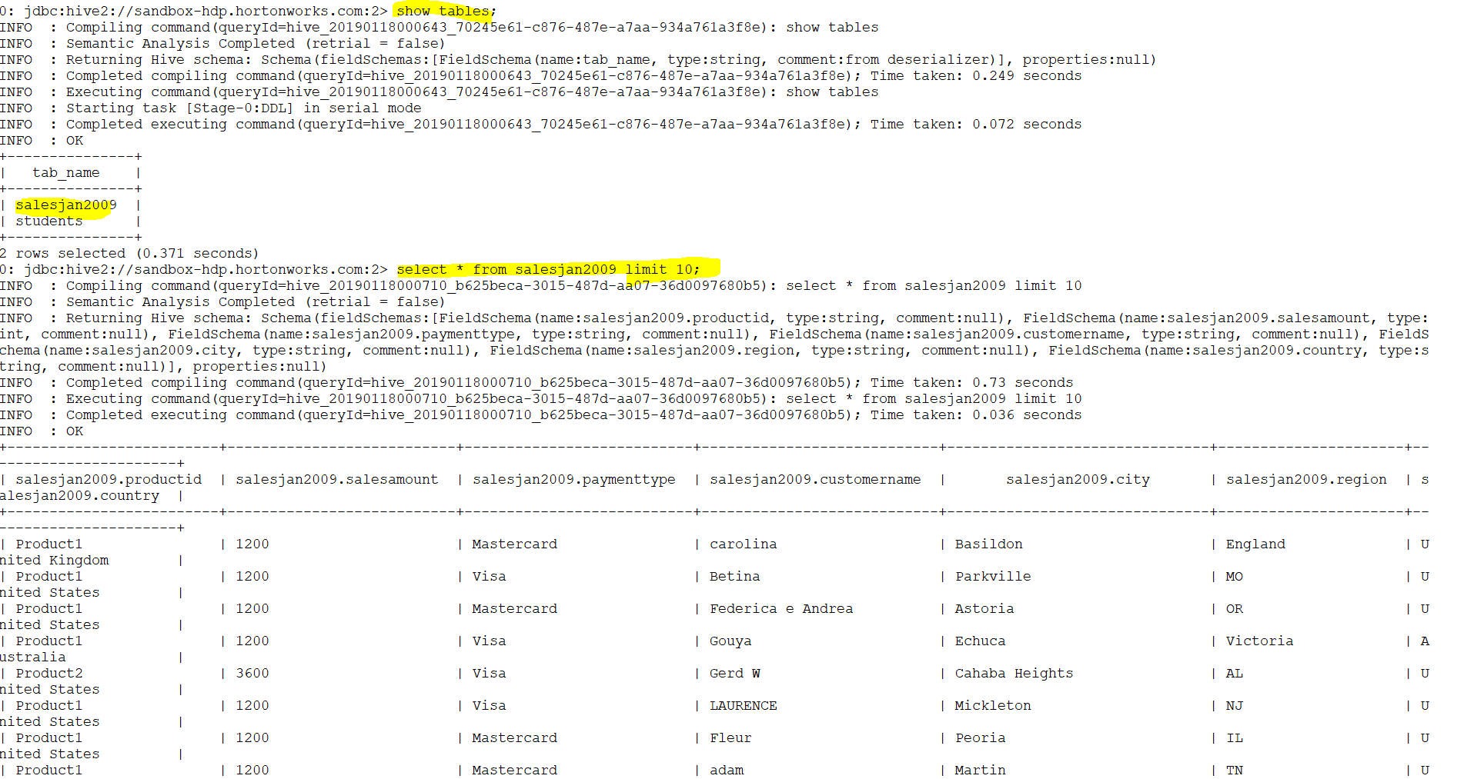

Slide 27
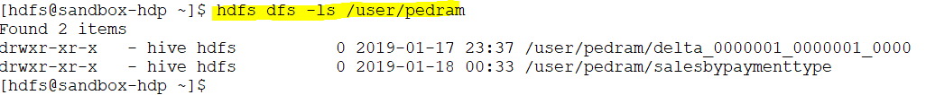
After I check the /user/pedram there is no salesjan2009 because we loaded

Slide 28
Notes:
If I were able to run it then I should see the header in the previous output.

Slide 29
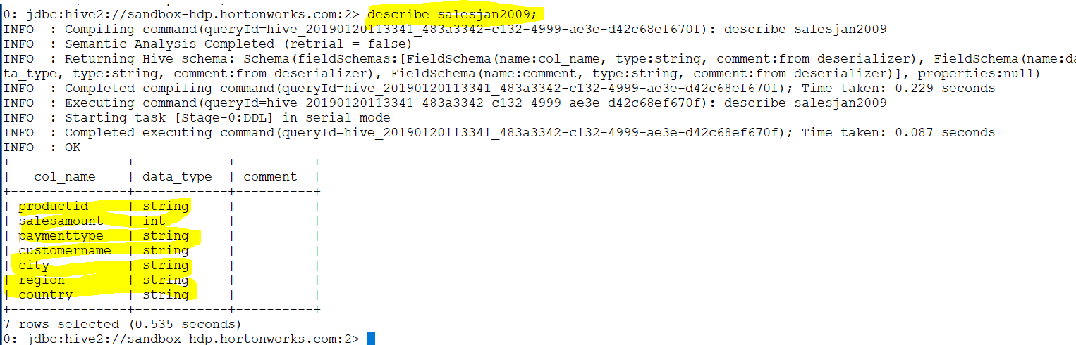

Slide 30
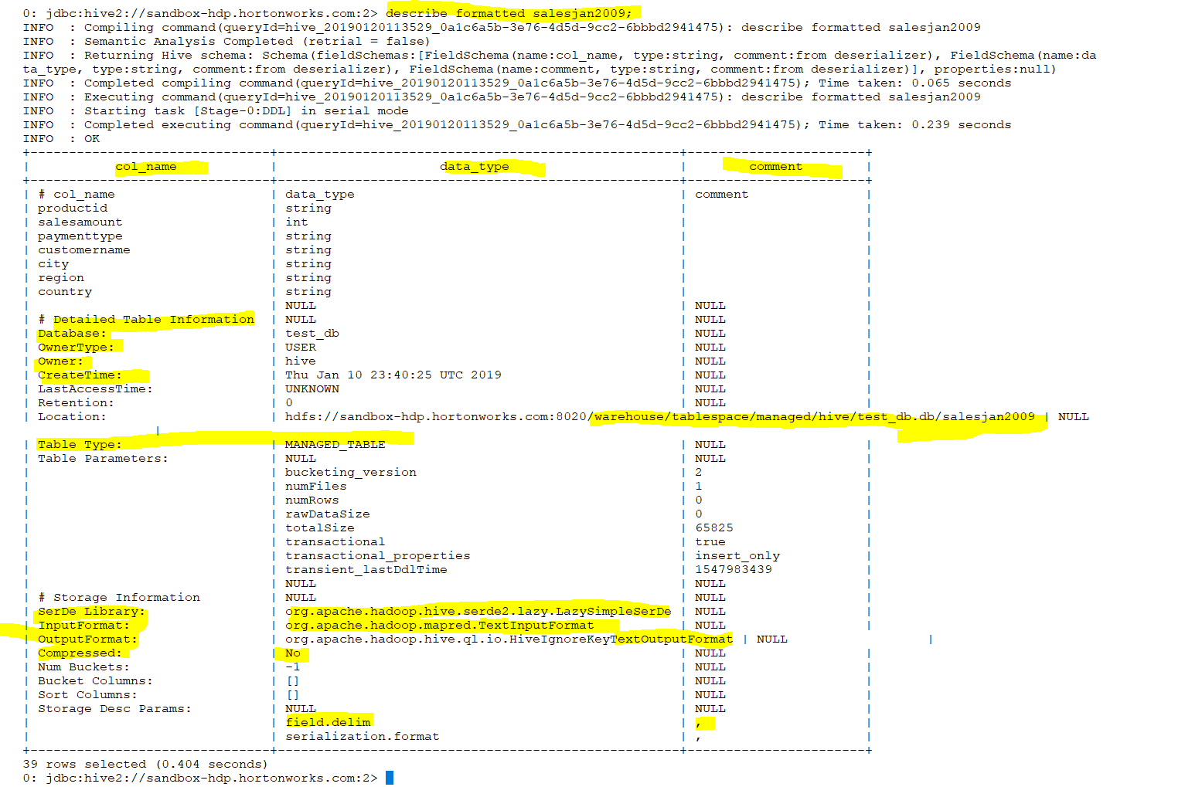
Notes:
In Hadoop we are doing serialization

Slide 31
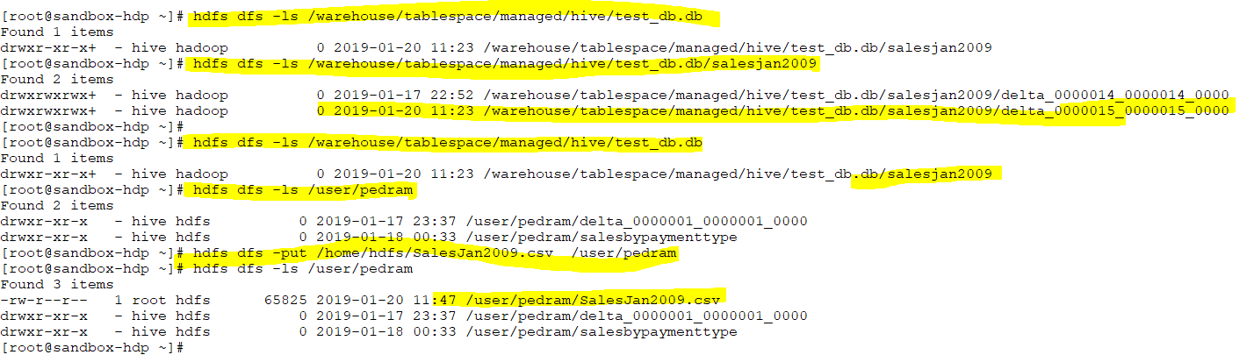
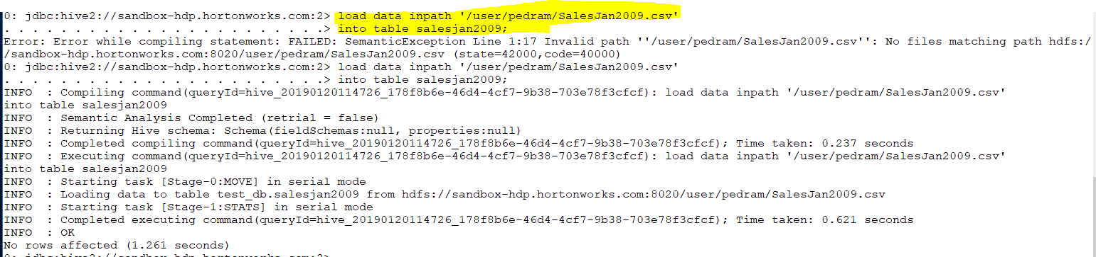
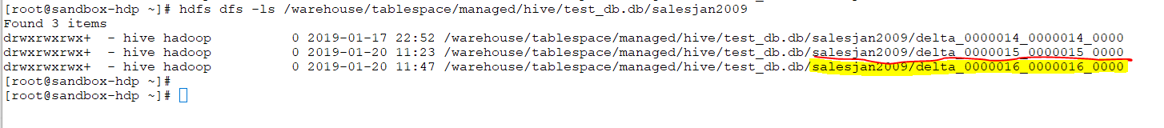
Notes:
After I load the table ,the slesjan2009 will be removed from /user/pedram then I have to put it again if I load the table again I should see another line under /warehouse/tablespace/managed/hive/test_db.db/salesjan2009

Slide 32
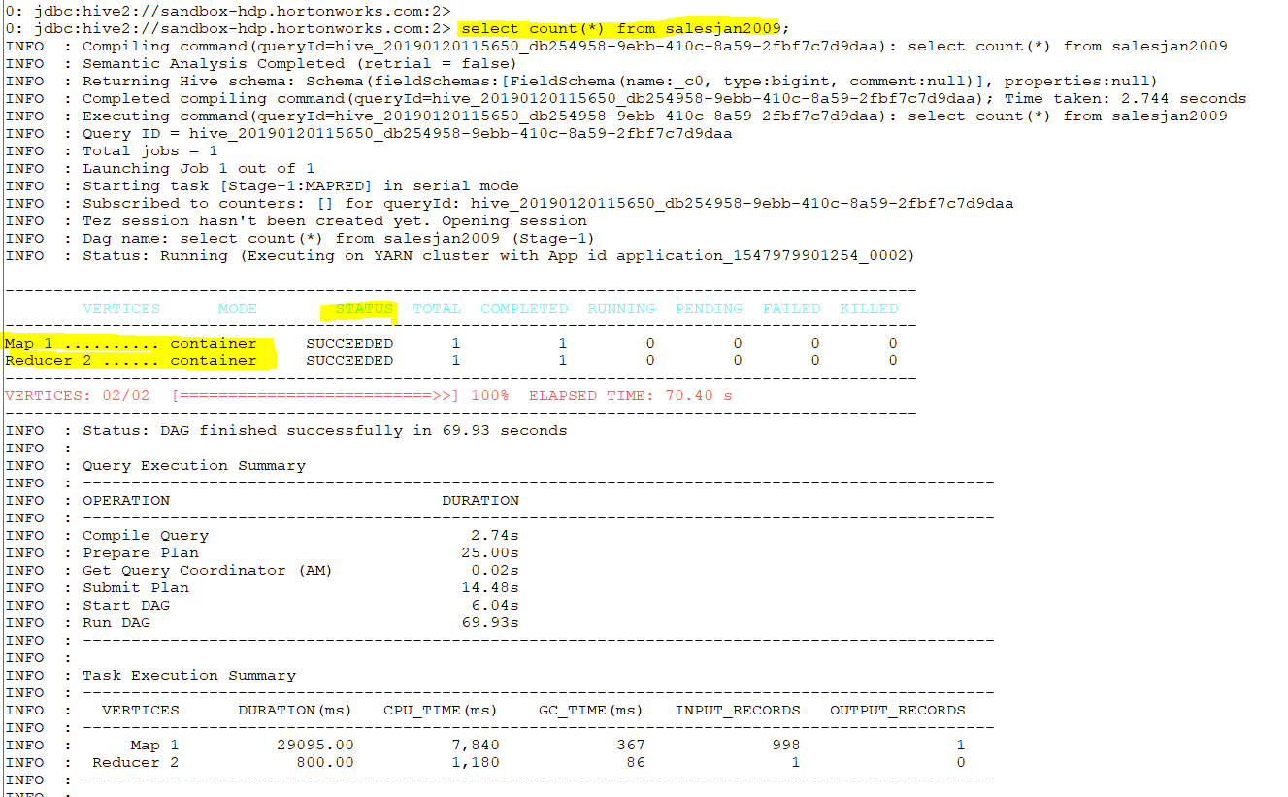
Notes:
It will tell us about number of entity . So Map reduce will run it. Count will start map reduce
We want the number of records. My query will be converted to MapReduce job internally by hive driver

Slide 33
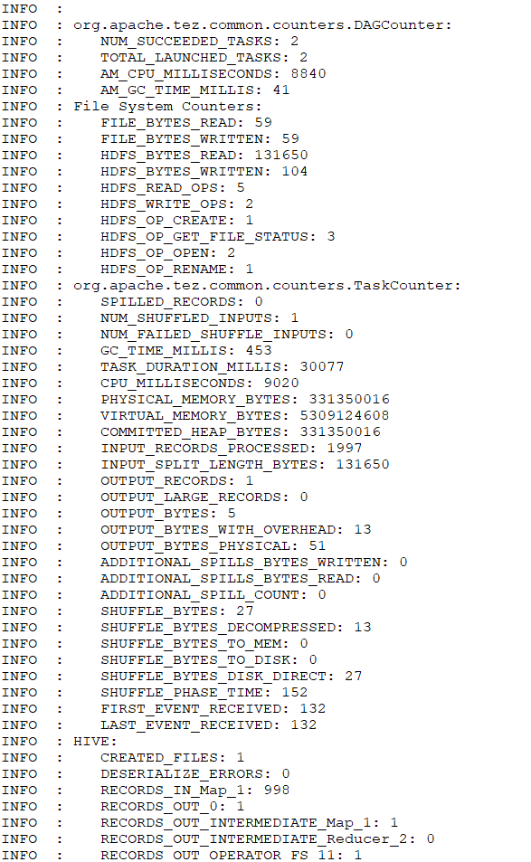
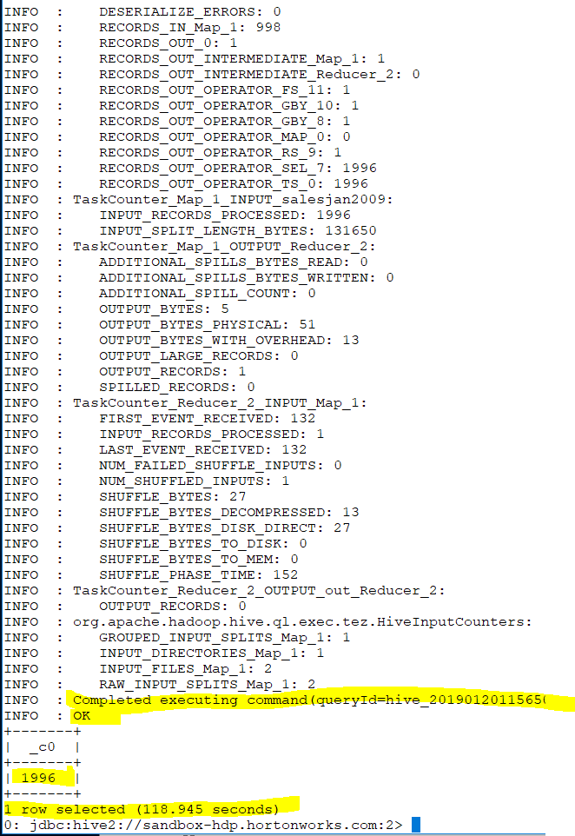

Slide 34
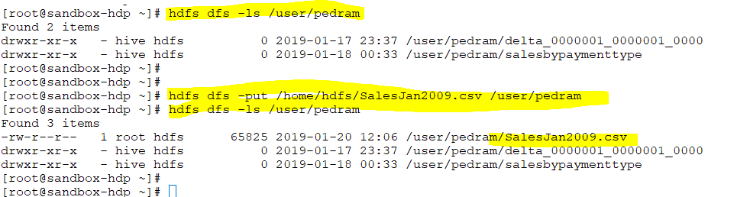
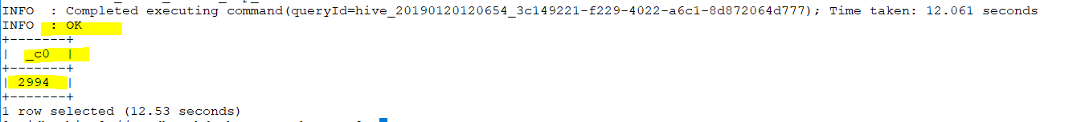
Notes:
If I put salesJan2009 again in /user/pedram and load the table then run count(*) we will see the value has been changed to 2994 so its appended.1996
Moreover new entity has been created.

Slide 35
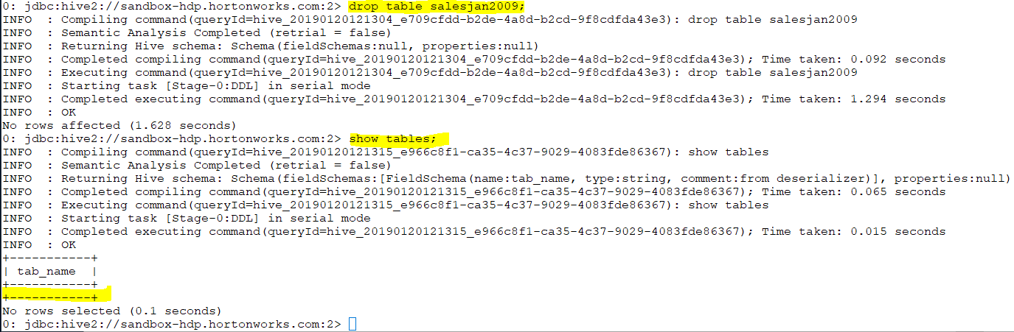
Notes:
The moment I drop the table all record or instance is gone.

Slide 36
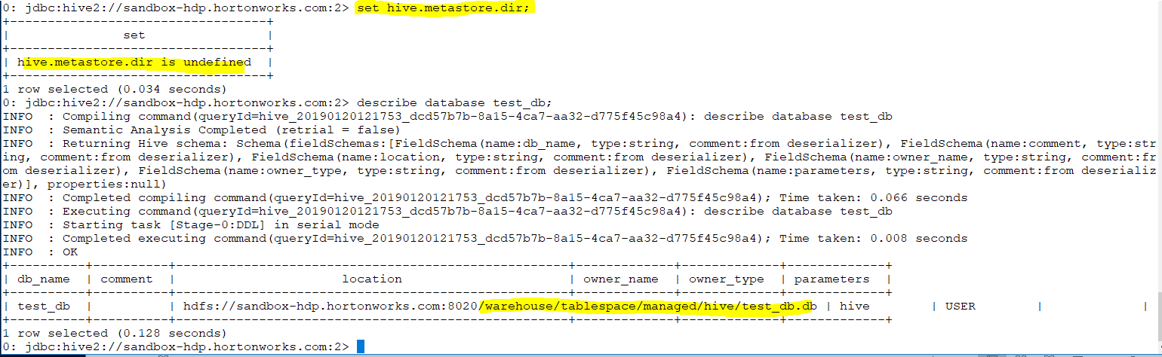
Notes:
Even you have not set the value in set but you see all the databases will be saved “/warehouse/tablespace/managed/hive/test_db.db/”
We can overwrite this by putting the location at the beginning
Like create database test_db location ‘hdfs/sdsvsd” if we are using public and do not have access to warehouse.

Slide 37
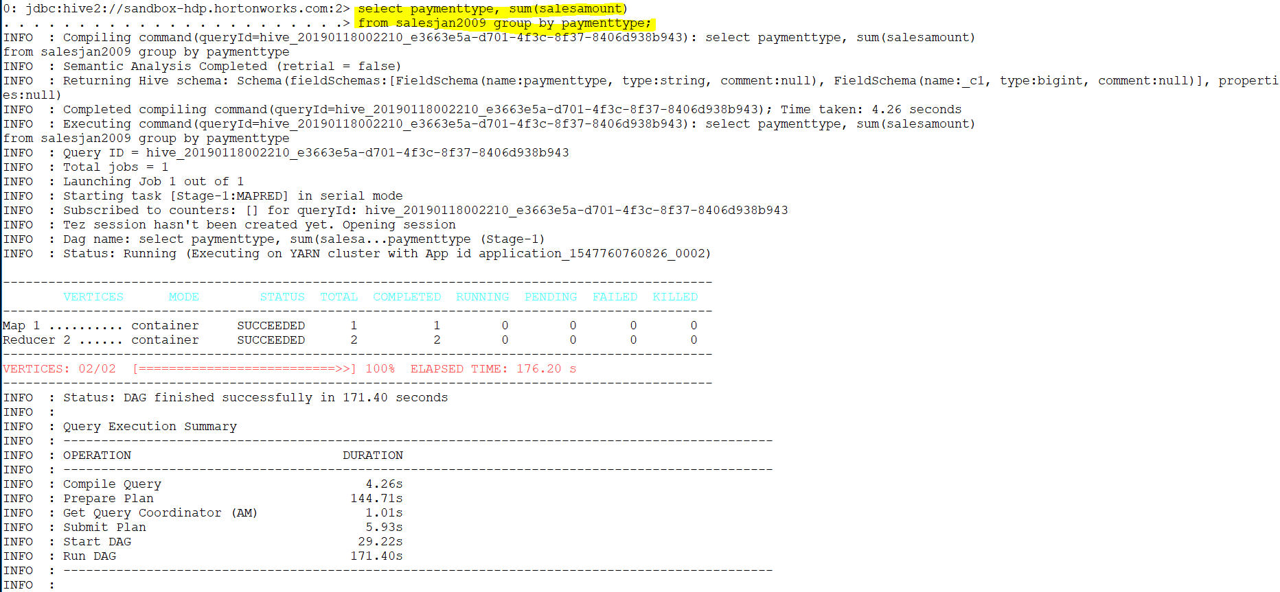

Slide 38
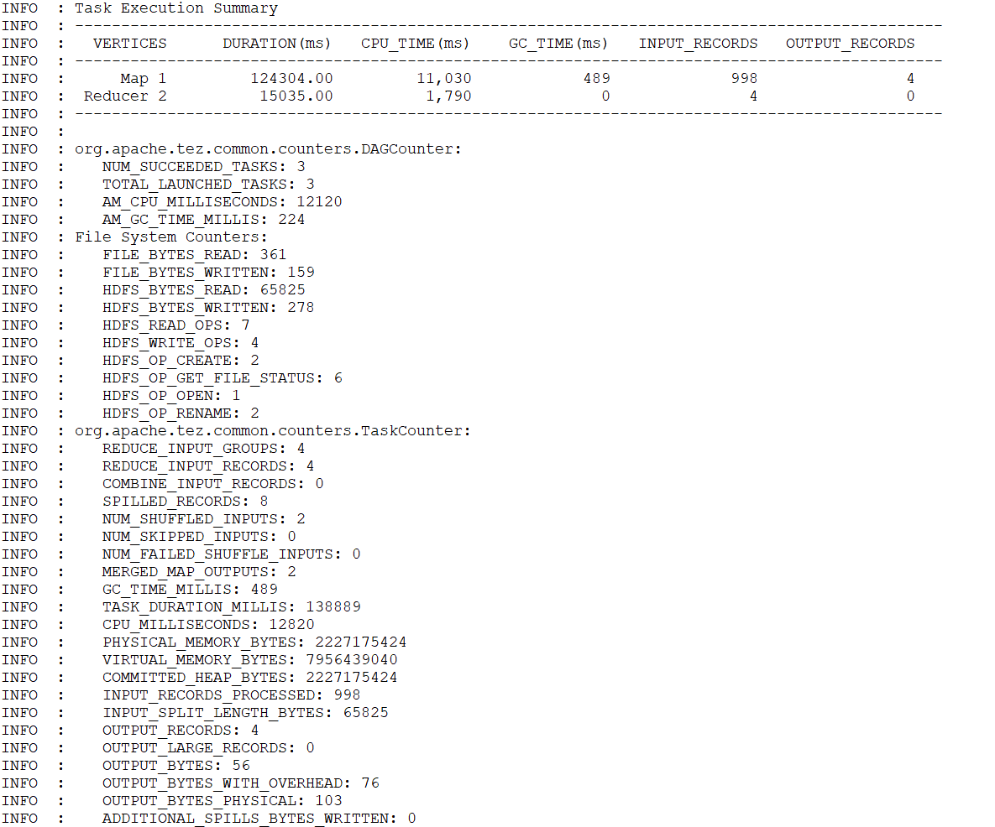

Slide 39
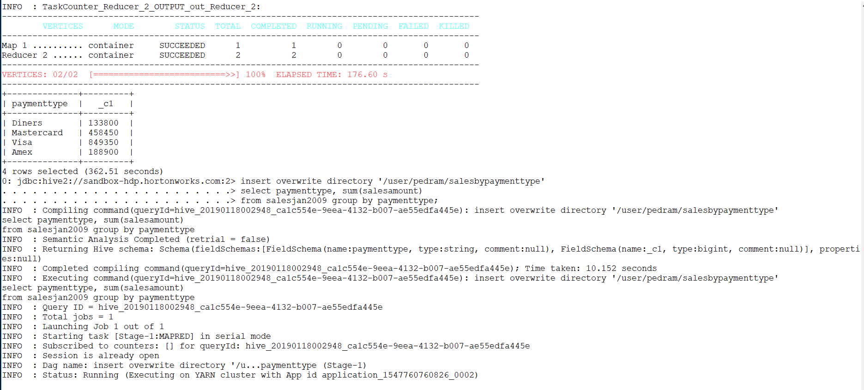

Slide 40
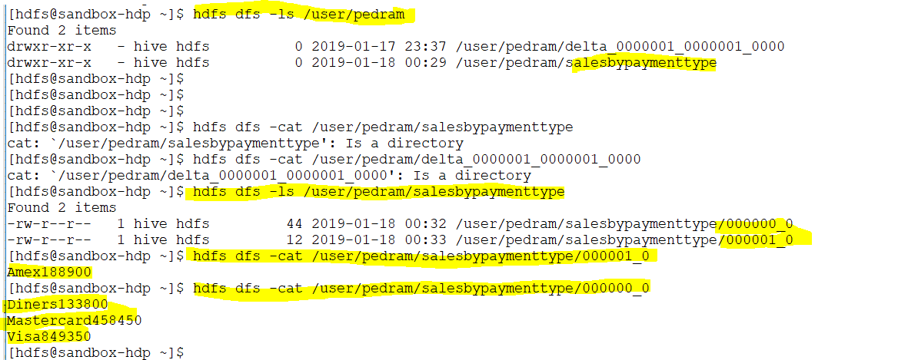

Slide 41
Managed table vs External Table
Notes:
Managed table : Hive manage the actual data itself and the meta data that’s why when we drop the table all the entities were removed from hdfs.
In fact the table directory itself was deleted. When you create a table it create a file and file inside it when you drop it remove the folder and file inside.
We need external table more than managed data .With describe we saw managed tables
External DB+
================
All my 10 years data in the HDFS now I need to analysis it then my data is already presented there.so I just need to analysis it. So we go with external

Slide 42
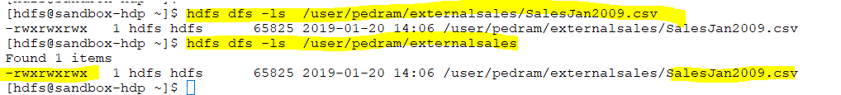

Slide 43
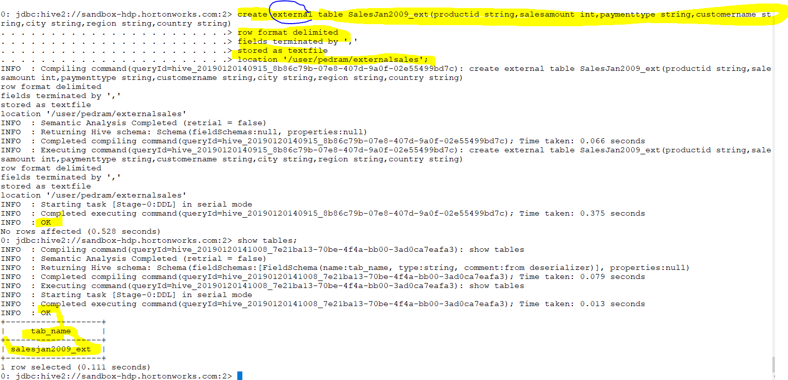

Slide 44
Notes:
If your data has been remove try the above command

Slide 45
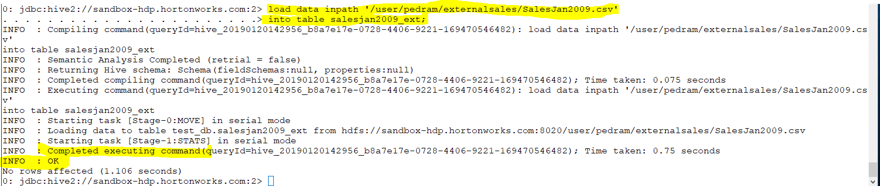

Slide 46
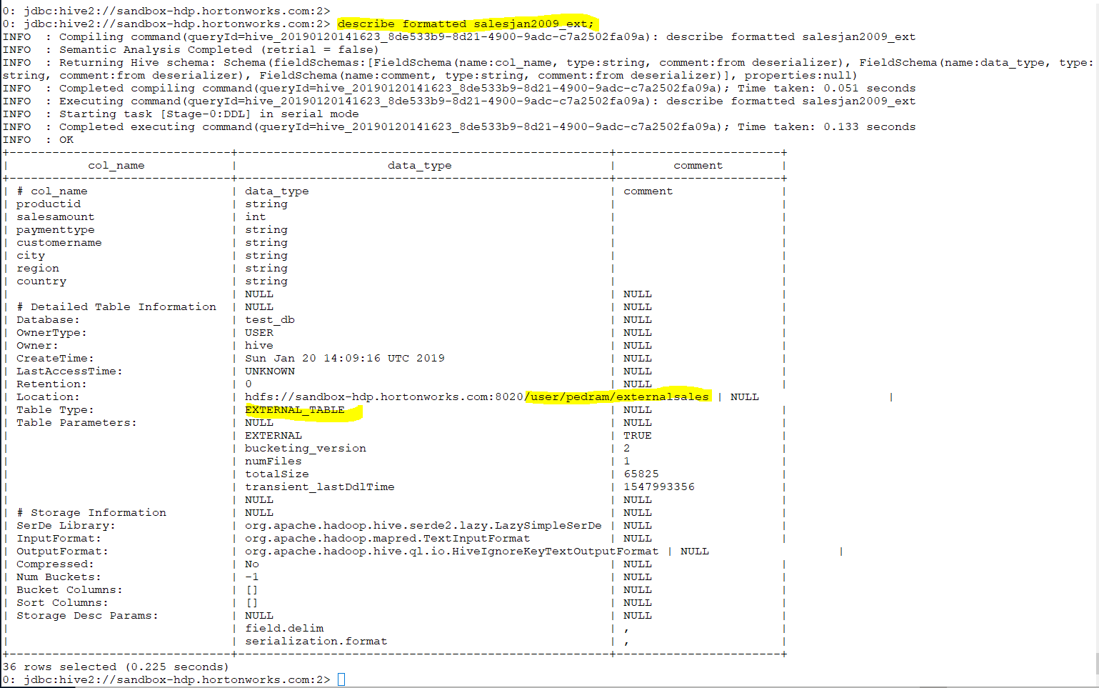

Slide 47
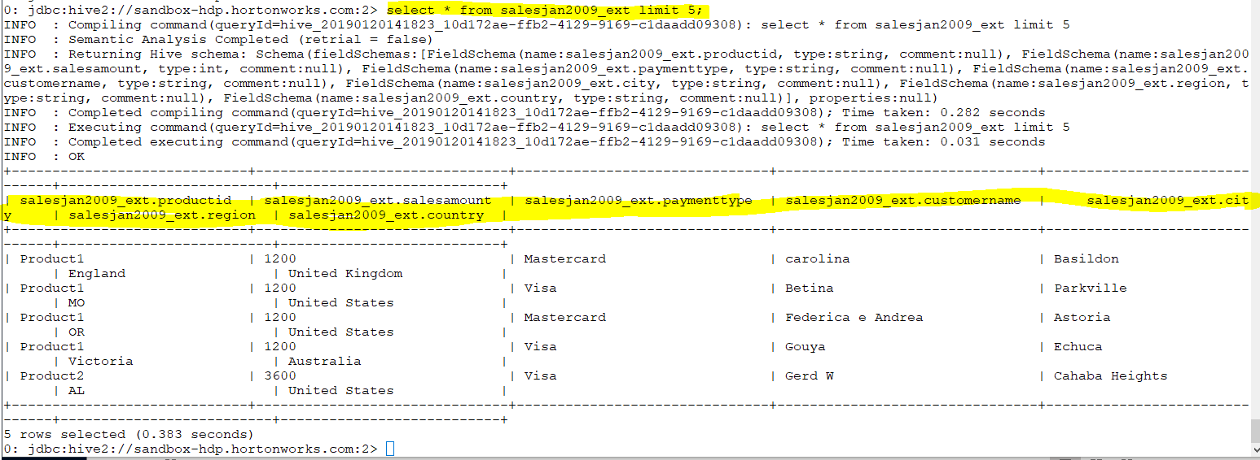

Slide 48


Slide 49


Slide 50


Slide 51

Notes:
If I load again for 2nd time
You see that it added second copy of it

Slide 52

Notes:
FYI
Imagine SalesJan2009 is all my 10 years data which we hold it in hdfs for future analysis
So we need to create metadata for this data so create a table .

Slide 53


Notes:
As you see hive does not have access to that location so I need to change it. so I need to go we differt location /user/pedram/pedram_hive_db/sales
=======================================================================================================
create table SalesJan2009(productid string,salesamount int,paymenttype string,customername string,city string,region string,country string)
row format delimited
fields terminated by ','
location '/warehouse/tablespace/managed/hive/pedram_hive_db/sales'

Slide 54

Notes:
When I drop an external table it only delete the metadata not actual data (2 copies are still there)

Slide 55


Slide 56

Notes:
We want to find out the total amount of sales amount per payment type like master credit card or visa)

Slide 57

Notes:
For external table we do not need to load the data
The whole idea was to create meta data

Slide 58

Notes:
We want to find out the total amount of sales amount per payment type like master credit card or visa)

Slide 59

Notes:
I create an external table without location then if I run describe formatted command it will let me know where does it go and create folder which is “/warehouse/tablespace/external/hive/test_db.db/salesjan2009_ext_without_loc”

Slide 60


Slide 61

If we already have data so we create external table with hdfs
If we do not have the data but we want to keep the data external we create without location
Notes:
Then if I go to /warehouse/tablespace/external/hive/test_db.db/salesjan2009_ext_without_loc I can see that the folder is already created.so hive creates an empty directory
Everything else remain the same with location.If we create an external location hive will go to that location and associate the metadata with that table and whenever we delete the metadata it will not delete the actual data
However in external without location everything is same except it will create an empty folder under warehouse which we can know about it by describe command.
In managed table when we delete the metadata it will delete the data too

Slide 62

Notes:
We create a new table does not matter is managed or external .
Then we use insert to load to this table

Slide 63

Notes:
Whatever is return by select table will be inset to sales_by_paymenttype

Slide 64

Notes:
You can run select to see the data however if you go to hdfs you can see that the actual directory and file (we can know about it by describe formatted command (next page.

Slide 65


Slide 66


Slide 67


Partition the data vs No partition
Notes:
You can see the above query will take 110 s .However if our data is 180 T what will happen .it might go to hours.so we need to partitioning our data
Partition the data vs No partition

Slide 68

Partitioning in Hive is very useful to prune data during query to reduce query times.
Notes:
We create a table with partitioning

Slide 69


Slide 70

Static Partitioning vs Dynamic partitioning
Notes:
In the current century, we know that the huge amount of data which is in the range of petabytes is getting stored in HDFS. So due to this, it becomes very difficult for Hadoop users to query this huge amount of data.
The Hive was introduced to lower down this burden of data querying. Apache Hive converts the SQL queries into MapReduce jobs and then submits it to the Hadoop cluster. When we submit a SQL query, Hive read the entire data-set. So, it becomes inefficient to run MapReduce jobs over a large table. Thus this is resolved by creating partitions in tables. Apache Hive makes this job of implementing partitions very easy by creating partitions by its automatic partition scheme at the time of table creation.
In Partitioning method, all the table data is divided into multiple partitions. Each partition corresponds to a specific value(s) of partition column(s). It is kept as a sub-record inside the table’s record present in the HDFS. Therefore on querying a particular table, appropriate partition of the table is queried which contains the query value. Thus this decreases the I/O time required by the query. Hence increases the performance speed.
=====================================================================================
i.Hive Static Partitioning
Insert input data files individually into a partition table is Static Partition.
Usually when loading files (big files) into Hive tables static partitions are preferred.
Static Partition saves your time in loading data compared to dynamic partition.
You “statically” add a partition in the table and move the file into the partition of the table.
We can alter the partition in the static partition.
You can get the partition column value from the filename, day of date etc without reading the whole big file.
If you want to use the Static partition in the hive you should set property set hive.mapred.mode = strict This property set by default in hive-site.xml
Static partition is in Strict Mode.
You should use where clause to use limit in the static partition.
You can perform Static partition on Hive Manage table or external table.
ii. Hive Dynamic Partitioning
Single insert to partition table is known as a dynamic partition.
Usually, dynamic partition loads the data from the non-partitioned table.
Dynamic Partition takes more time in loading data compared to static partition.
When you have large data stored in a table then the Dynamic partition is suitable.
If you want to partition a number of columns but you don’t know how many columns then also dynamic partition is suitable.
Dynamic partition there is no required where clause to use limit.
we can’t perform alter on the Dynamic partition.
You can perform dynamic partition on hive external table and managed table.
If you want to use the Dynamic partition in the hive then the mode is in non-strict mode.
Here are Hive dynamic partition properties you should allow
https://data-flair.training/blogs/apache-hive-partitions/

Slide 71

Static Partitioning vs Dynamic partitioning
Notes:
Partitioning in Hive is very useful to prune data during query to reduce query times.

Slide 72

Notes:
You see that it is static partitioning which is very useful so if we have our csv file already partitioned then it will be easy
Imaging we have few files ; one for Jan one for Feb and one for March so its easy for us to look in to it
Same as above example

Slide 73


Notes:
Lets look at another example for month=Jan so we create a new table and we will load the data and we see that it creates a directory in warehouse

Slide 74


Slide 75


Slide 76
Notes:
We can do the same for salesFeb2009 but this is rarely happens because data are already mix with Jan and Feb so this methods is called static partitioning and its useful when you have already partitioned your data.
We already have our file splatted to different months but it will not have this file splitted in production

Slide 77

Notes:
We create a dynamic table .Create a table which has all data from sales then create a partition table

Slide 78

Notes:
We see there is no directory created
Make sure it is norestrict

Slide 79

We can not load in dynamic partition. Dynamic always load from existing table . So we use insert not load in our dynamic table
Notes:
v

Slide 80

Notes:
So it will run select first then it will partition it then it will create 4 groups based on payment type then it insert it in the sales_dyn_part folder
Remember : in dynamic partitioning always it choose the last column which is paymenttype here

Slide 81



Slide 82

Notes:
After ruuning the previous command it will create a folder and there are four folder inside it based on payment type

Slide 83

Notes:
As you can see the pyment type .why ? Because the payment type is there .We use in the partition

Slide 84

Notes:
So we run another query
We need to find the total sale for each payment type and then compare it with the one which we did not use partition

Slide 85


Slide 86

Notes:
This is from previous example which we did not have partition and you see that the time is 110 second compare with using partition which is 35 seconds.

Slide 87

Notes:
Another example
You see it takes 0.865 which is from not partition table
Lets run from partition table and compare it

Slide 88


Notes:
You see that it takes 0.473 which less than 0.85
So for partition table takes less time
Sales_dyn_part is a table which is partitioned

